Slide 1

RULES OF TAKING ANNUAL LEAVE DAYS (Validity: 1st Apr 2015)

Slide 2
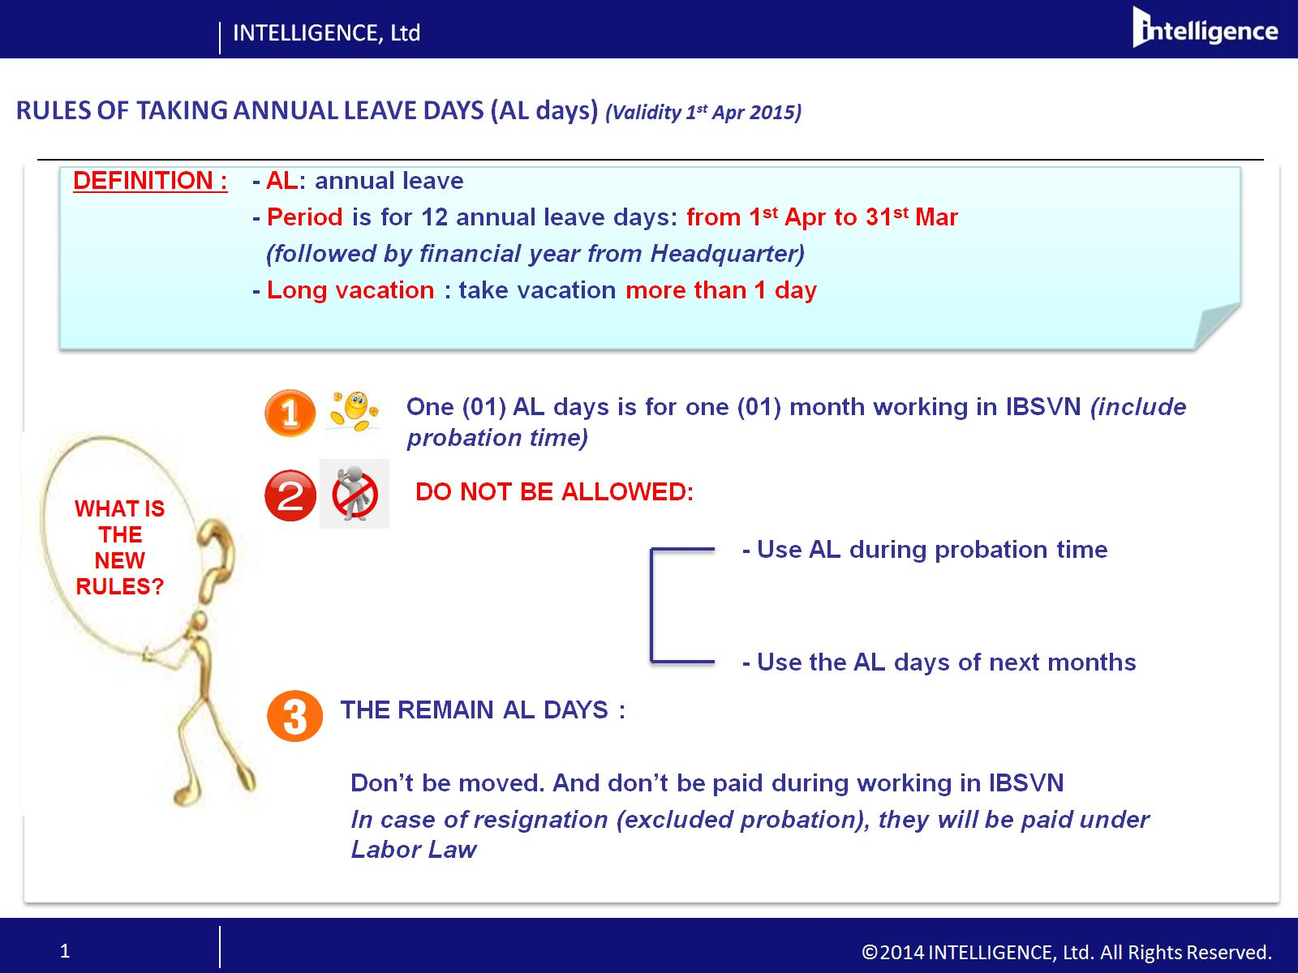

Slide 3
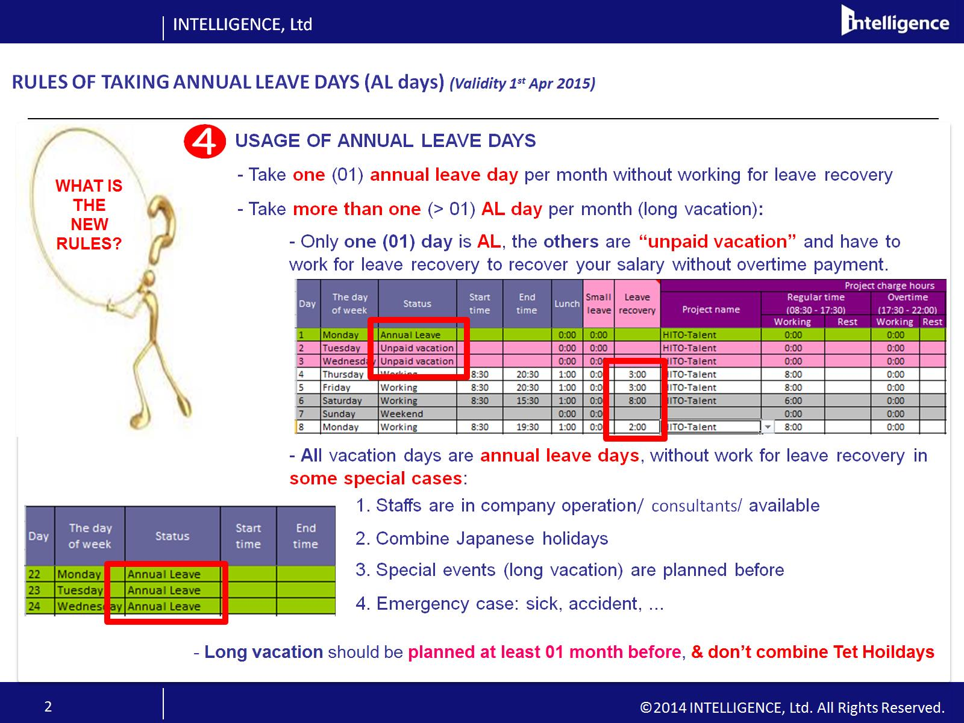
ó

Slide 4
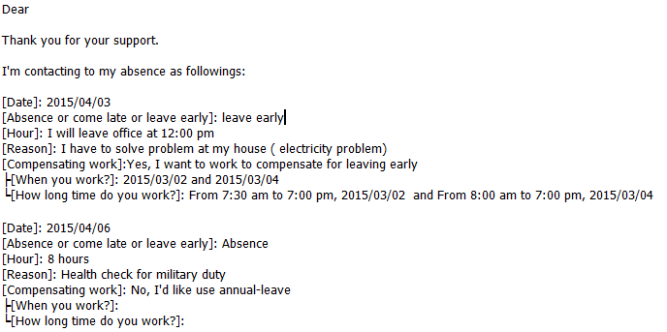
To send an email to stakeholder :
1. If you stay at home, please use Web Mail : https://owa.inte.co.jp/owa/
2. Please ask your project leader, project manager
3. Please CC to :your team members and IBSV_Attendance FY160000003346@inte.co.jp
4. Please use absent format

Slide 5
